Slide 1


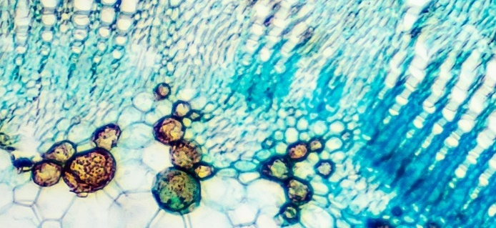
INTERIM RESULTS
Six months to 30 June 2020
16 September 2020
Strictly Private and Confidential

Slide 2
DISCLAIMER
This presentation has been prepared by and is the sole responsibility of the directors of Futura Medical plc (the “Company”). This presentation does not constitute a recommendation regarding the shares of the Company nor a representation that any dealing in those shares is appropriate. The Company accepts no duty of care whatsoever to the reader of this presentation in respect of its contents and the Company is not acting in any fiduciary capacity. The information contained in the presentation has not been verified, nor does this presentation purport to be all-inclusive or to contain all the information that an investor may desire to have in evaluating whether or not to make an investment in the Company. In all cases potential investors should conduct their own investigations and analysis concerning the risks associated with investing in shares in the Company, the business plans, the financial condition, assets and liabilities and business affairs of the Company, and the contents of this presentation.
This presentation (including its contents) is confidential and is for distribution in the United Kingdom only, to persons who are authorised persons or exempted persons within the meaning of the Financial Services and Markets Act 2000 or any Order made thereunder, or to persons of a kind described in Articles 19 or 49 or 50 of the Financial Services and Markets Act 2000 (Financial Promotion) Order 2005 (as amended) and, if permitted by applicable law, for distribution outside the United Kingdom to professions or institutions whose ordinary business involves them in engaging in investment activities. It is not intended to be distributed or passed on, directly or indirectly, to any other class of persons.
No offer or invitation or solicitation of any offer to acquire securities of the Company is being made now nor does this presentation constitute or form part of any invitation or inducement to engage in investment activity under section 21 of the Financial Services and Markets Act 2000. No reliance may be placed for any purpose whatsoever on the information contained in this presentation or any assumptions made as to its completeness and no warranty or representation is given by or on behalf of the Company nor its directors, employees, agents and advisors as to the accuracy or completeness of the information or opinions contained in this presentation and no liability is accepted by any of them for any such information or opinions, provided that nothing in this paragraph shall exclude liability for any representation or warranty made fraudulently. The information and opinions contained in this presentation are provided as at the date hereof. This presentation is not, and should not be construed as, a recommendation or advice by the Company or its advisers to potential investors to participate in any investment in the Company.
The contents of this presentation are confidential and must not be copied, published, reproduced, distributed or passed in whole or in part to others at any time by recipients. This presentation is being provided to recipients on the basis that they keep confidential any information contained herein or otherwise made available, whether oral or in writing, in connection with the Company.
This presentation may contain certain forward-looking statements. Whilst the directors believe all such statements to have been fairly made on reasonable assumptions, there can be no guarantee that any of them are accurate or that all relevant considerations have been included in the directors' assumptions; accordingly, no reliance whatsoever should be placed upon the accuracy of such statements, all of which are for illustrative purposes only, are based solely upon historic financial and other trends and information, including third party estimates, and may be subject to further verification. Neither the Company nor its directors makes any representation or warranty in respect of the accuracy, completeness or verification of the contents of the Presentation Materials.
In particular, this presentation should not be distributed, published or reproduced in whole or in part or disclosed by recipients to any other person or entity and, in particular, should not be distributed to United States residents, corporations, or other entities, US persons (as defined in Regulation S promulgated under the United States Securities Act of 1933 (as amended), persons with addresses in the United States of America (or any of its territories or possessions), Canada, Japan, the Republic of Ireland, the Republic of South Africa or Australia, or to any corporation, partnership or other entity created or organised under the laws thereof, or in any other country outside the United Kingdom where such distribution may lead to a breach of any law or regulatory requirement. Notwithstanding the foregoing, the Company can distribute this document to US Persons (as defined above), persons with addresses in the United States of America (or its territories or possessions), United States residents, corporations or other entities if the Company is satisfied that an applicable exemption applies. Distribution of this document in the United States of America in the absence of such an applicable exemption may constitute a violation of United States
securities law.

Slide 3

CORPORATE OVERVIEW

Slide 4



ABOUT FUTURA - CORPORATE OVERVIEW
FUNDAMENTALS
FUTURA IS LISTED ON AIM AND LOCATED AT THE RESEARCH PARK, GUILDFORD
‘Virtual’ organisation with 13 staff and low overheads
Significant outsourced infrastructure with over 30 consultants
DERMASYS®
APPLYING SKIN SCIENCE TO DELIVER NOVEL TOPICAL CLINICALLY PROVEN TREATMENTS
DermaSys® is our proprietary patented transdermal technology with rapid and targeted delivery
A versatile, clear, odourless gel uniquely formulated to provide optimal results for each therapeutic indication
TRACK RECORD
CLINICALLY PROVEN INNOVATION USING EXISTING PHARMACEUTICAL COMPOUNDS
Sexual health and pain relief focus
Late stage products with experienced Management Team
KEY PORTFOLIO PRODUCTS
MED3000 – TOPICAL GEL FOR THE TREATMENT OF ERECTILE DYSFUNCTION (ED)
Highly differentiated treatment with rapid speed of onset and excellent side effect profile
EU submission for marketing authorisation filed in July 2020
TPR100 – TOPICAL GEL FOR THE TREATMENT OF PAIN RELIEF
UK regulatory dossier previously submitted and scientific advice meeting with regulators expected in Q4 2020
CBD100 – TOPICAL GEL CONTAINING CANNABIDIOL
Initial laboratory and optimisation work complete with superior delivery of cannabidiol into the skin

Slide 5


SIX MONTH HIGHLIGHTS – PRODUCTS, ORGANISATION & FINANCIAL
Strategic decision to focus on maximising R&D pipeline value by de-risking assets
Priority remains MED3000 research and development for regulatory submissions and approvals
Further realisation of value from pain relief portfolio
Progression of MED3000 out-licensing discussions in parallel with remaining R&D requirements
Submission to Notified Body¹ as Class 2B medical device available OTC² throughout the EU filed
Positive opinion issued by EU Notified Body¹ for Futura’s QMS³ for MED3000
Two pre-submission meetings with FDA confirming likely OTC² and De Novo medical device status in USA
Third FDA pre-submission meeting set before the end of October to finalise remaining data requirements
Specialist corporate advisers appointed to facilitate licensing and marketing partner discussions
MED3000
PAIN
RELIEF
MHRA required lab work for TPR100 complete and scientific advisory meeting expected before end of 2020
Compelling CBD100 in vitro data with up to 8 times superior permeation versus competitor product
Patent application on CBD100 novel formulation submitted
Net loss in the period: £1.06 million (Net loss 30 June 2019: £4.46 million)
Cash resource at 30 June 2020: £ 2.62 million
A Notified Body is an organisation designated by EU regulators to assess conformity of medical devices before being placed on the market
Over the Counter - No regulatory requirement for a doctor’s prescription for supply of the medical treatment
Quality Management System

Slide 6


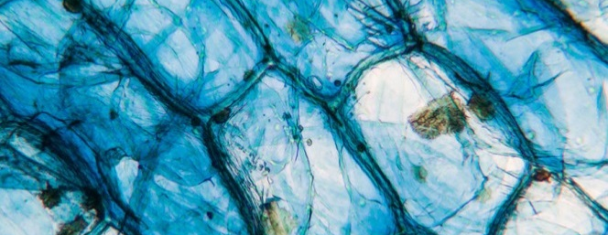
Strategic outlook
❶
Gain approval for MED3000 as a clinically proven treatment for erectile dysfunction within the next 12-18 months
❷
Realise shareholder value from MED3000 through commercialisation with distribution partners
❸
Expand the potential of our transdermal technology, DermaSys®, from our pain relief portfolio

Slide 7

MED3000 – AN INNOVATION IN THE TREATMENT OF ED
LEAD PRODUCT
⁷

Slide 8

UNMET MEDICAL NEED IN ED
A SOLUTION IS NEEDED THAT HELPS TO RESTORE INTIMACY AND SPONTANEITY
There is a significant unmet need for a treatment that is efficacious and well-tolerated, that works within minutes, and that facilitates intimacy, forming part of sexual foreplay for a spontaneous sexual experience for both partners
About 50% of men with ED across all ages do not discuss their condition with their physician, and of those who do, over 67% do not receive treatment¹
Oral PDE5 inhibitors are the cornerstone of modern ED therapy, but do not meet the needs of many men and their partners¹
Up to half of patients discontinue treatment within 1 year², citing concerns which include barriers to spontaneity and intimacy, insufficient efficacy, and side effects
Works
rapidly
Enables
spontaneity
EFFICACIOUS
Well
tolerated
Restores
intimacy
Jannini J Sex Med. 2014 Jan;11(1):40-50, Rosen Curr Med Res Opin. 2004 May;20(5):607-17
Corona G., “First-generation phosphodiesterase type 5 inhibitors dropout (…)”, Andrology, 2016, 4, 1002–1009;

Slide 9
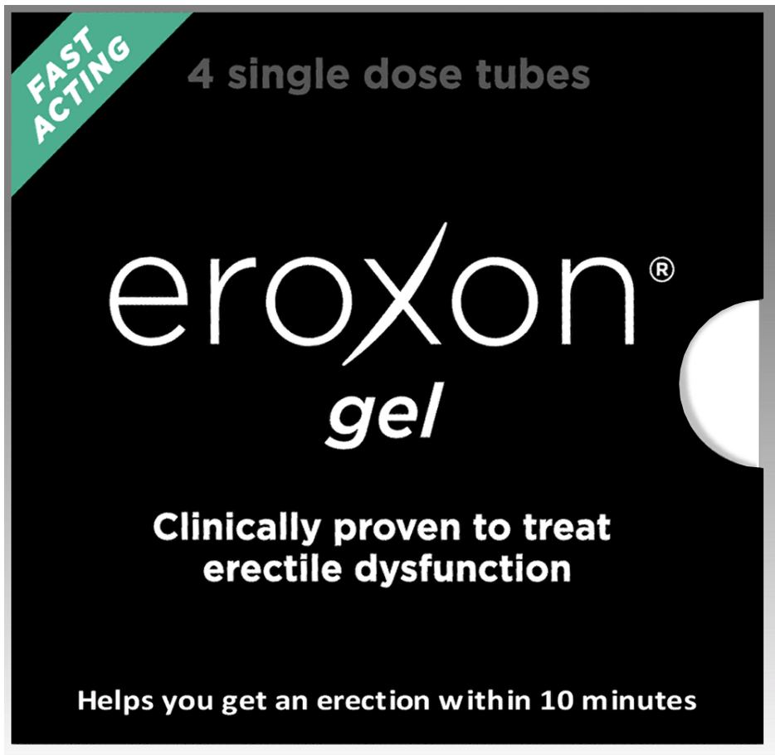
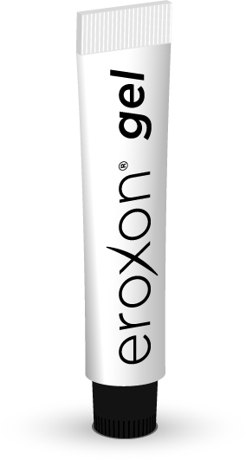
MED3000: A BREAKTHROUGH CLINICALLY PROVEN TREATMENT
FOR ED
1
Potential first worldwide OTC product clinically proven to treat ED
2
No pre-planning for sex. Goes to work in 10 minutes or less
3
Clinically proven to be effective in mild, moderate and severe ED
4
Minimal side-effects, no adverse drug interactions
5
Strong patent protection based on unique DermaSys® technology
6
Medical device classification; expedited approval process
7
Low cost of goods
Ex works price from EU/FDA approved EU based manufacturer. Discussions underway with potential US/Can based manufacturer.

Slide 10
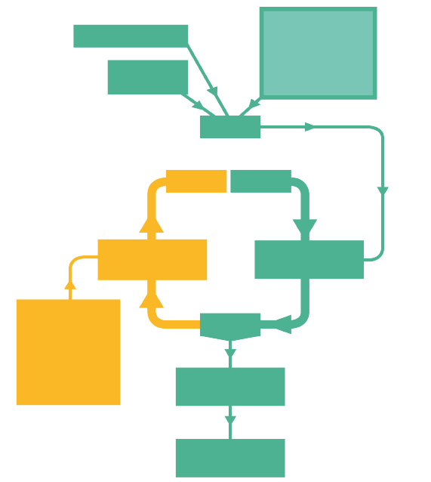
MED3000 MODE OF ACTION
MED3000 (DermaSys®) promotes sensory stimulation of the nerves on the glans penis by rapid cooling and recovery warming, leading to fast smooth muscle relaxation, tumescence and erection
MED3000
Novel evaporative action stimulates nerve sensors in the highly innervated glans penis through temperature, touch and pressure
Endothelial cells
^{Natural NO production}
NANC
neurons
NO
GMP
GTP
cGMP-specific phosphodiesterase type 5
^{Soluble}
^{guanylyl cyclase}
PDE5i: PDE5 inhibition
Oral treatment with systemic absorption. Primarily selective
^{for PDE5}
cGMP
^{NO = Nitric Oxide}
^{GMP = guanosine monophosphate}
cGMP = cyclic guanosine monophosphate
^{GTP = guanosine triphosphate}
NANC = Nonadrenergic, noncholinergic
Smooth muscle relaxation
Tumescence and penile erection

Slide 11
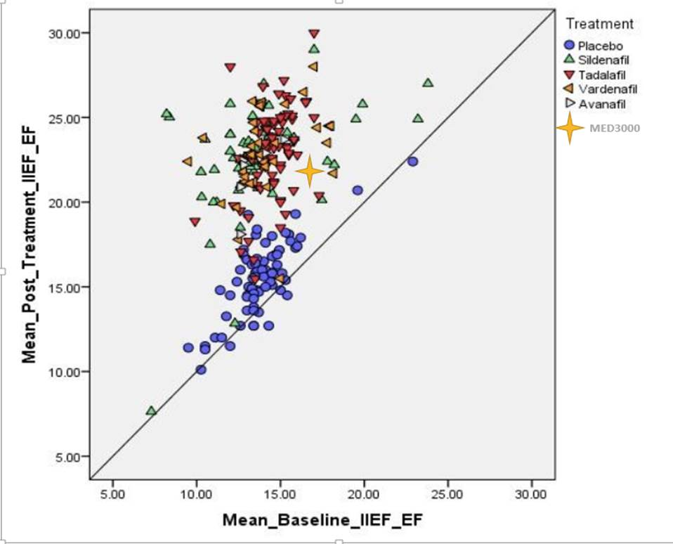
MED3000 Comparative efficacy to Published data¹ on PDE5i’s
MED3000 results as efficacious as low dose PDE5 inhibitors and significantly better than placebo
Side effect profile far superior to all PDE5 inhibitors
Speed of onset far superior to all on demand PDE5 inhibitors
Erectile Dysfunction AUA Guideline 2018, Appendix B1, Guideline Statement 8

Slide 12
MED3000 – ESTIMATED REGULATORY TIMELINES
US – De Novo Medical Device
EU – Class II Medical Device
FDA Meeting Request
Submit meeting request
Provide summary data
Dec 2019

QMS Evaluation
Map out EU requirements for company QMS
Dec 2019

Medical device EU
Pre-Submission Meeting (1st )
Initial meeting to determine classification
Q1 2020

EU Notified ² Body Selection
Selection and commission of EU Notified Body²
Q1 2020

Pre-Submission Meeting (2nd)
Review FM57 CSR¹ to determine data sufficiency
July 2020

QMS³
Update
Updating of Futura’s QMS³ for MED3000
July 2020

Pre-Submission Meeting (3rd)
Agreement on remaining FDA data requirements
End of Oct 20
Application Submission
Submission of MED3000 Technical Dossier
July 2020

Two remaining requirements for “Direct to OTC” approval
Small confirmatory clinical
Development of a suitable OTC label
QMS
approval
Positive opinion issued on QMS³ for MED3000
Aug 2020

Medical device EU
EU Regulatory approval
Expected EU marketing authorisation
2021
Application Submission
Submission of MED3000 dossier
End of 2021
USA Regulatory approval
Expected USA marketing authorisation
2022
Clinical Study Report
Notified Bodies are the regulatory authorities that oversee the approval of medical devices within the EU including the UK
Quality Management System

Slide 13

MED3000
Commercial

Slide 14
OTC AVAILABILITY OPENS UP LARGE UNTAPPED MARKET
TRADITIONAL SEGMENTS
NEWER SEGMENTS
PDE5IS USERS
(SATISFIED AND DISSATISFIED)
DIAGNOSED,
NOT TREATING
UNDIAGNOSED,
SUSPECTED
YOUNG MEN
PARTNERS
Drivers of switch to MED3000
Fast acting, no planning necessary (spontaneity)
Very favourable side effects profile
OTC availability
For dissatisfied users the top two are even more relevant.
~ 20% of ED patients are contra-indicated¹
~ 50% drop out after the first year on oral PDE5s therapy²
Only 1 in 4 men diagnosed with ED in the US is on treatment³
Embarrassment of speaking to the doctor
Cost and inconvenience
Huge appeal for OTC availability to overcome barriers
The prevalence of ED in young men is increasing; now as high as 30%⁴
Barriers to treatment are even higher for this category and OTC availability fits with their lifestyle.
ED treatment is most effective when partner is involved.
Partners currently feel helpless and frustrated as they want to be more involved.
They want a more intimate and spontaneous solution
Global ED prescription
market $5.6bn (2018)⁵
Significant OTC opportunity
73%⁶ of OTC sales would be from patients not currently on treatment
POTENTIAL FOR A NEW OTC CATEGORY
MED3000’S KEY ATTRIBUTES MAKE IT AN ATTRACTIVE OTC TREATMENT
IPSOS FORECAST OF GLOBAL OTC OPPORTUNITY FOR MED3000
$660M⁷
1.Cello Healthcare Consulting research amongst physicians in the US, France and Germany, commissioned by Futura ; 2. Corona G., “First-generation phosphodiesterase type 5 inhibitors dropout (…)”, Andrology, 2016, 4, 1002–1009; 3. Frederick L., “Under treatment of erectile dysfunction: claims analysis of 6.2 million patients”, J Sex Med, 2014, Oct, (10):2546-53; 4. Nguyen Sex Med Rev. 2017 Oct, vol 5, 508-520; 5. MSP 2018: Data for 75 countries, IQVIA IMS Health; 6. Ipsos research commissioned by Futura 7. Directors’ belief based on market research conducted on Company’s behalf by Ipsos

Slide 15


SIGNIFICANT COMMERCIAL POTENTIAL
1
Global ED prescription market worth over US$5.6 billion in 2018¹
2
Potential 1st worldwide OTC product clinically proven to treat ED
3
$660 million potential ‘Over the Counter’ sales²
4
Specialist corporate advisors appointed Q3 2020
5
Out-licensing discussions with different potential partners for worldwide rights
IPSOS RESEARCH
Ipsos scenario
 | Year 3 | Year 5 | Year 10
RSP ($m) | 500 | 584 | 661
Manufacturers’ Selling Prices 2018: 15 Key ED markets, IQVIA (IMS) Health
Directors’ belief based on Ipsos market research conducted on Company’s behalf

Slide 16

TOPICAL PAIN RELIEF

Slide 17
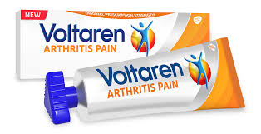
TOPICAL PAIN RELIEF – TPR100
1
Global sales of over the counter topical analgesics US$ 4.9 billion¹
February 2020 - Approval in the US of GSK’s Voltaren Arthritis Pain Gel over the counter opening up a new OTC market opportunity
2
Demand for safe, effective and long lasting topical pain relief
DermaSys® provides faster drug permeation, a key point of difference
3
TPR100 is a Diclofenac gel that utilises Futura’s DermaSys® technology
Improved permeation compared to market leaders at same dosage
1
Agreement signed with Thornton & Ross (part of STADA) for UK rights
UK regulatory submission first responses received - additional laboratory work recently completed Q3 2020
Scientific advisory meeting with MHRA planned before end of 2020
Amount of Diclofenac permeated ug/cm²
2
Commercial discussions ongoing with other potential distributors
TPR100 - USA will require further clinical data to support regulatory submission
1 – Mid year to 2017, Nicholas Hall ‘s OTC Reports, Analgesics The Evolving Self-Care market for pain relief

Slide 18
Topical Cannabidiol with DermaSys®- CBD100
Joint venture signed with CBDerma Technology to fund development of DermaSys® based cannibidiol formulation
Providing a near term opportunity under cosmetic regulations as a superior product in respect of absorption
Longer term CBD100 could be supported with strong clinical evidence for registration as a drug (medicinal) product
A patent application has been filed for CBD100’s key attributes
Next steps being discussed and explored with CBDerma
SUPERIOR IN-VITRO PERMEATION
INTO THE SKIN
THROUGH THE SKIN
Permeation of CBD100 versus
popular Competitive Product
100
20000
Permeation of CBD100 versus
popular Competitive Product
17500
80
15000
Formulation
CBD100
12500
60
Popular competitive
product
10000
7500
40
5000
20
2500
CBD 100
POPULAR COMPETITIVE
PRODUCT
0
0
3
6
9
12
15
18
21
24
Time (hr)

Slide 19

FINANCIAL RESULTS
& OUTLOOK
¹⁹

Slide 20



INTERIM HIGHLIGHTS – ORGANISATION & FINANCIALS
Net loss of £1.06 million in period
  (30 June 2019: net loss of £4.46 million)
Cash resources of £2.62 million at 30 June 2020
(30 June 2019: £5.63 million)
Funding
Current cash sufficient to Q2 2021
Exploring a number of funding options including non-dilutory funding sources to complete remaining, supplementary data once requirements confirmed by FDA

Slide 21



OUTLOOK
1
EU approval of MED3000 as a fast acting clinically proven OTC treatment for ED during 2021
FDA supplementary data requirements confirmed and study completed during 2021
2
Commercial discussions regarding out-licensing agreements for MED3000 on a worldwide, regional or country basis
3
Progress on TPR100 MHRA regulatory submission pending scientific advice meeting outcomes
4
Updates on development of CBD100 – topical cannabidiol formulation using DermaSys®

Slide 22
appendix

Slide 23
FM57 – PHASE 3 STUDY DESIGN
FM57
A Phase 3, 12 week dose-ranging, multi-centre, randomized, double-blind, placebo-controlled, home use, parallel group clinical trial of topically applied GTN for the treatment of ED in 1,000 male subjects with ED & their female partners
Run-in
period
Treatment
period
Subjects pre-screening
HEADLINE
OBJECTIVES
Primary objective:
To demonstrate statistically significant improvements of formulations versus baseline in male subjects using the erectile function domain of the International Index for Erectile Function (IIEF), the Sexual Encounter Profile (SEP) Question 2 & 3
Secondary objectives included:
Time to onset of action
Safety of formulations using Adverse Events
Clinically important differences
GAQ and SEAR
4-week run-in period to establish degree of patient’s erectile dysfunction (“Baseline”)
MED2005 0.2%
N=250
MED2005 0.4%
N=250
MED2005 0.6%
N=250
MED3000
N=250
Follow up
period
Follow up visit
STUDY SITES
Central and Eastern Europe (6 EU countries & 3 non-EU countries)
PRODUCTS TESTED formulated with DermaSys®
MED2005 0.2% GTN, 300 mg gel = 0.6mg GTN
MED2005 0.4% GTN, 300 mg gel = 1.2mg GTN
MED2005 0.6% GTN, 300 mg gel = 1.8mg GTN
Control vehicle– DermaSys® alone now called MED3000

Slide 24
FM57 HEADLINE RESULTS – MED3000 PATIENT REPORTED OUTCOMES
Clinically Important Differences at 12 weeks – Percentage of patients who noticed a meaningful difference¹
MED3000 | Overall Responders (%) | Mild/Moderate/Severe ED Responders (%)
IIEF (Rosen) | 63 | 61/59/80
SEP2 (Araujo) | 75 | 83/57/77
SEP3 (Araujo) | 68 | 71/61/71
Using Rosen and Araujo Criteria (Internationally accepted standards)

Slide 25
EFFICACY AND SAFETY OF MED3000 OBSERVED DATA VS CIALIS®
Side Effect Profile
MED3000 versus Cialis®
%
%
IIEF-EF
Score
Adverse Events | MED3000³ (N=250) | Cialis® 5mg (N= 151)
Headache | 3% | 11%
Dyspepsia | 0% | 8%
Back pain | 0% | 5%
Myalgia | 0% | 4%
Nasal Congestion | 0% | 3%
Flushing | 0% | 3%
Pain in Limb | 0% | 3%
1. The ability to insert penis into the vagina 2. Erection long enough for intercourse 3. 1.2% penile burning noticed in males and 0.4% vulvovaginal burning in females with MED3000

Slide 26

MED3000 RAPID SPEED OF ONSET
DURATION OF APPLICATION AND SPEED OF ONSET
SPEED OF ONSET – MED3000
MED3000
application
8% - Almost
immediately
32% - Under
5 minutes
60% - Under
10 minutes
75% - Under
20 minutes¹
10% - Not at
all
1
60% subjects saw a speed of onset within 10 minutes of application
2
  Faster speed of onset than oral PDE5i’s
3
  In comparison – Viagra Connect starts to work in 30-60 minutes²
Gel is applied and massaged for 15 seconds
0
5
10
Speed of Onset (from application)
Time (minutes)
83% of patients had onset within 30 minutes and a further 7% more than 30 minutes
Viagra Connect PIL in UK

Slide 27
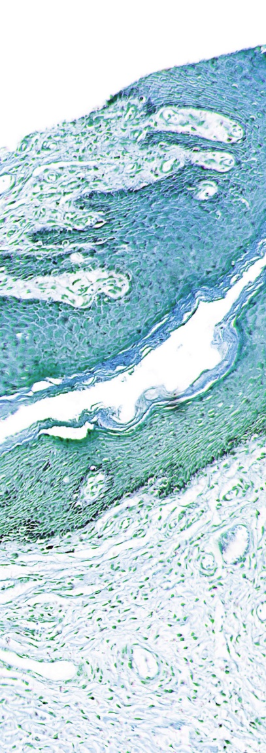
TOPICAL PAIN RELIEF – CBD100
Joint venture signed with CBDerma Technology to fund development of DermaSys® based cannibidiol formulation (CBD100)
Cannibidiol one of 113 Cannabinoids found in Cannabis
Cannibidiol is a non-psychoactive cannabinoid with many anecdotal reports of therapeutic activity in a variety of conditions suitable for topical treatment such as pain relief
Many existing cannibidiol based gels are poorly formulated to penetrate into skin and underlying tissues, and are not supported with scientific and clinical evidence
Cannabidiol is known to lose its potency throughout its shelf life unless it is specially formulated
CBD100 has been developed to strict pharmaceutical principles using the superior DermaSys® technology

